Slide 1
Deep Face Recognition
De
ep Face Recognition
Wen-Hao Wu
Ibrahim Kemal Yasar
Vivek Patel

Slide 2
Table of Contents
Introduction
Related Work
Dataset Collection
Methodologies
Datasets and evaluation protocols
Experiments and results
Conclusion

Slide 3
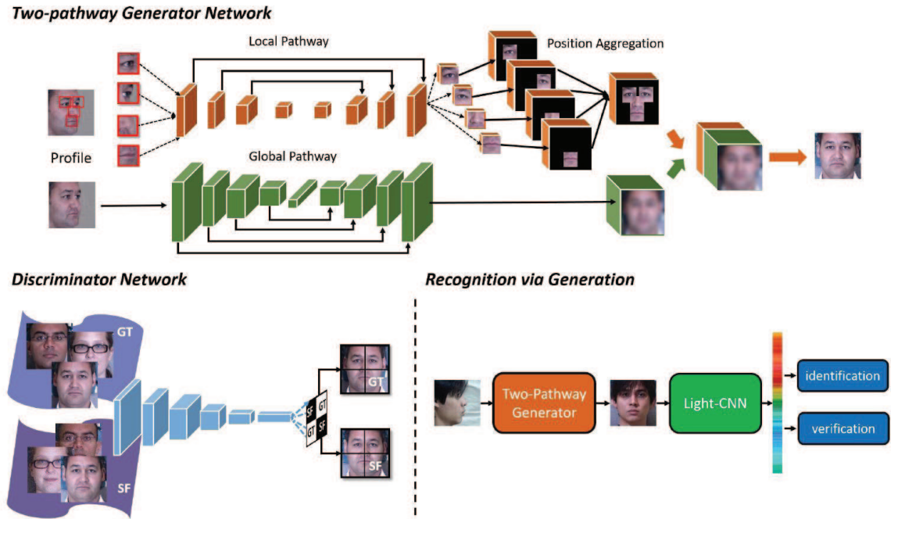

Slide 4
Introduction
Goals:
To propose a procedure to create a large face dataset
To investigate various CNN architectures for face identification and verification

Slide 5
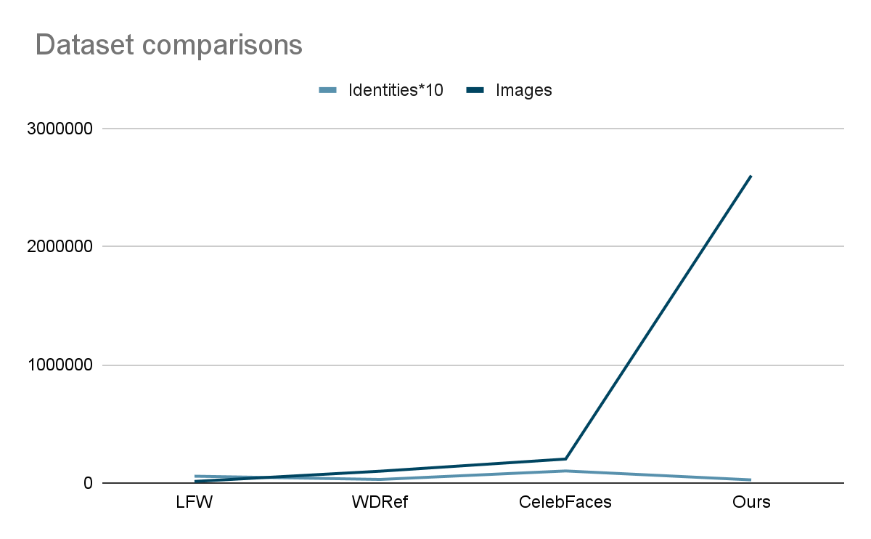
 | Identities | Images
Ours | 2622 | 2.6M
Google | 8M | 200M
FaceBook | 4030 | 4.4M
Largest collection of face images outside industrial datasets by Google and Facebook

Slide 6
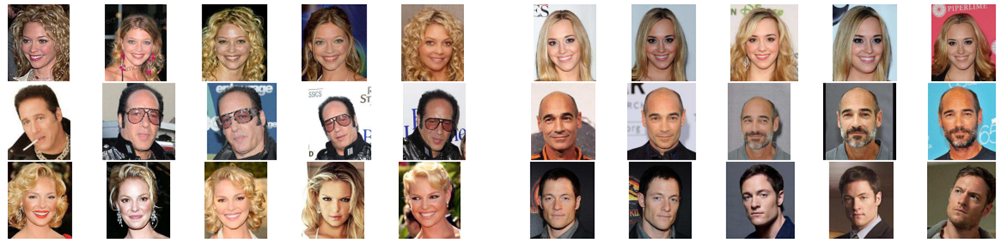
Related Work
Example images from our dataset for six identities

Slide 7
Dataset Collection
Stage 1. Bootstrapping and filtering a list of candidate identity names
Stage 2. Collecting more images for each identity
Stage 3. Improving purity with an automatic filter
Stage 4. Near duplicate removal
Stage 5. Final manual filtering

Slide 8
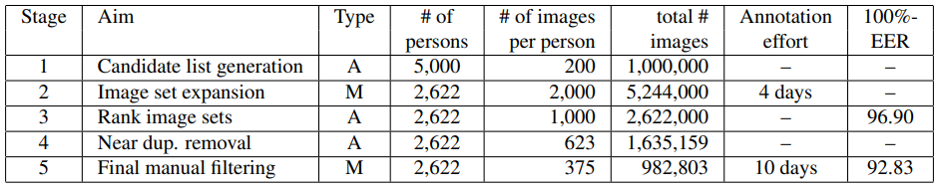
Dataset statistics after each stage of processing

Slide 9
Main Methodologies
Covolutional Neural Network
Bootstrapping
Triplet Loss
Notes:
In the upcoming slides, I will talk about the main methodologies that was used in this paper. I will go through CNN, Bootstrapping, and Triplet loss. There are a lot more topics mentioned in this paper. However, I will just go through the core topics which in my opinion are worth talking about.

Slide 10
What are Artifitial Neural Networks?
Notes:
So, before we dive into CNN, first question, what are ANNs?

Slide 11
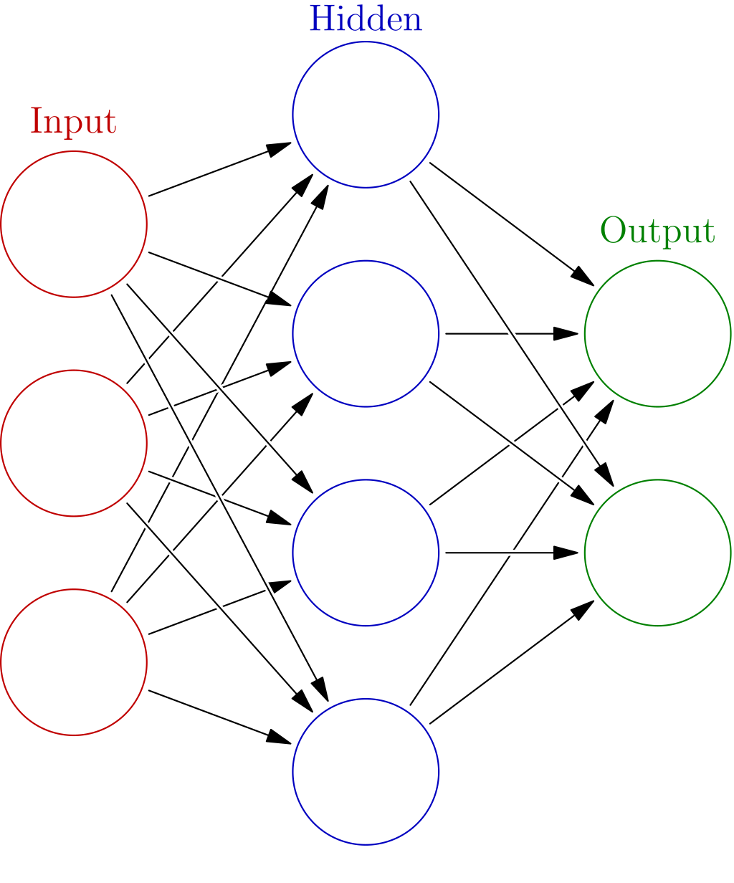
Artifitial Neural Network
ANNs are inspired by biological neural networks
Basic Structure: Input, Hidden, and Output layers
Weights between layers to adjust Inputs
Notes:
ANNs are inpired by biological neural networks. The basic structure is Input, Hidden, and Output layers. There are weights between layers to adjust the inputs and eventually have an impact on the outputs. As simple as that.

Slide 12
What differentiates ANN and CNN?
Notes:
So, What is the difference between ANN and CNN?

Slide 13
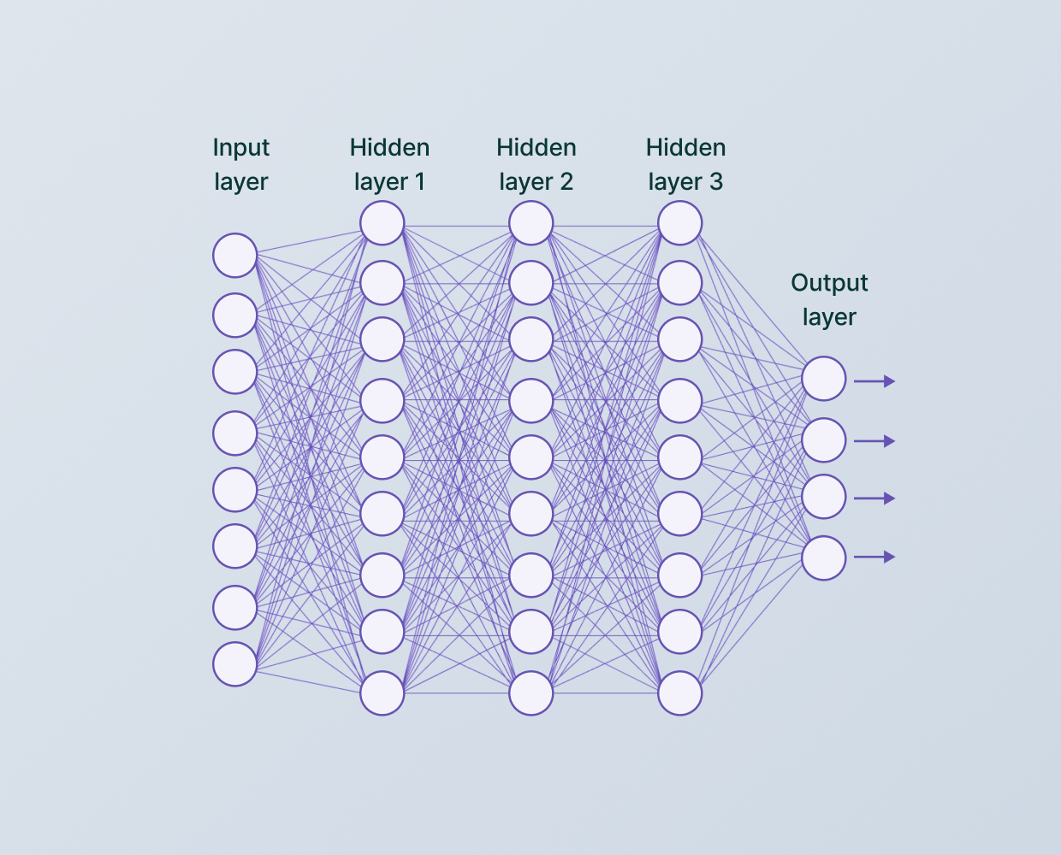
Convolutional Neural Network
CNNs have hidden layers called “Convolutional Layers”
a Convolutional Layer receives input and then transforms the input in some way and outputs the transformed input to the next layer
Notes:
CNN also has the same structure as ANNs but the hidden layers are called Convolutional layers. a Convolution layer receives input, transforms input, and pass it to the next layer. Just like the other ANNs.

Slide 14
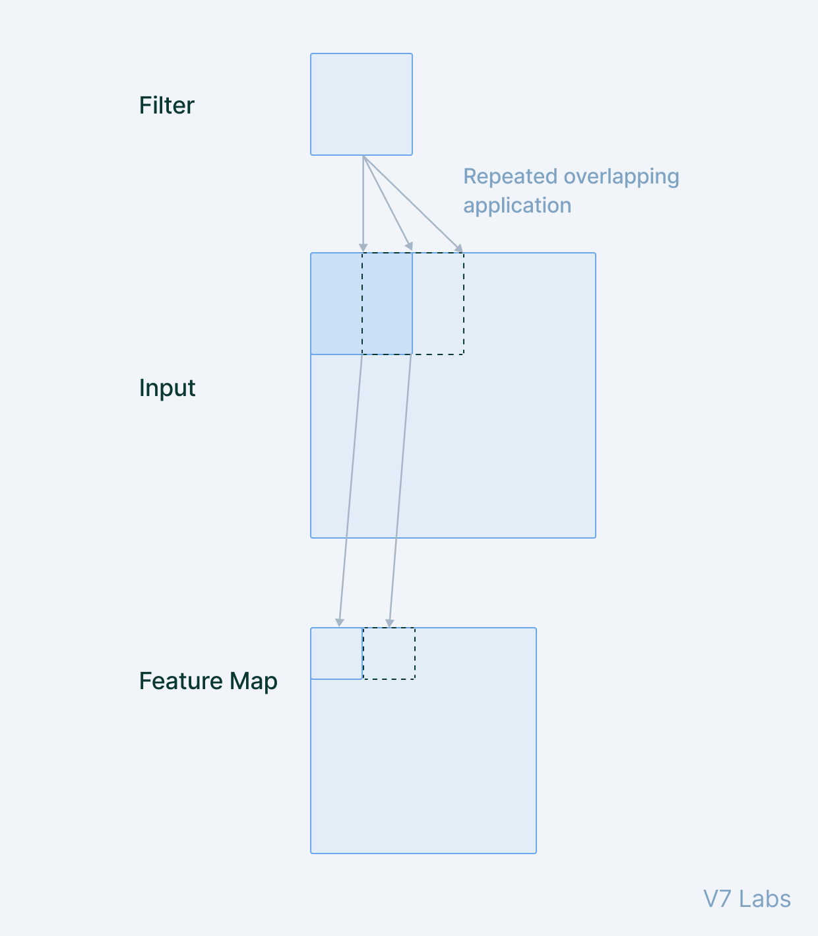
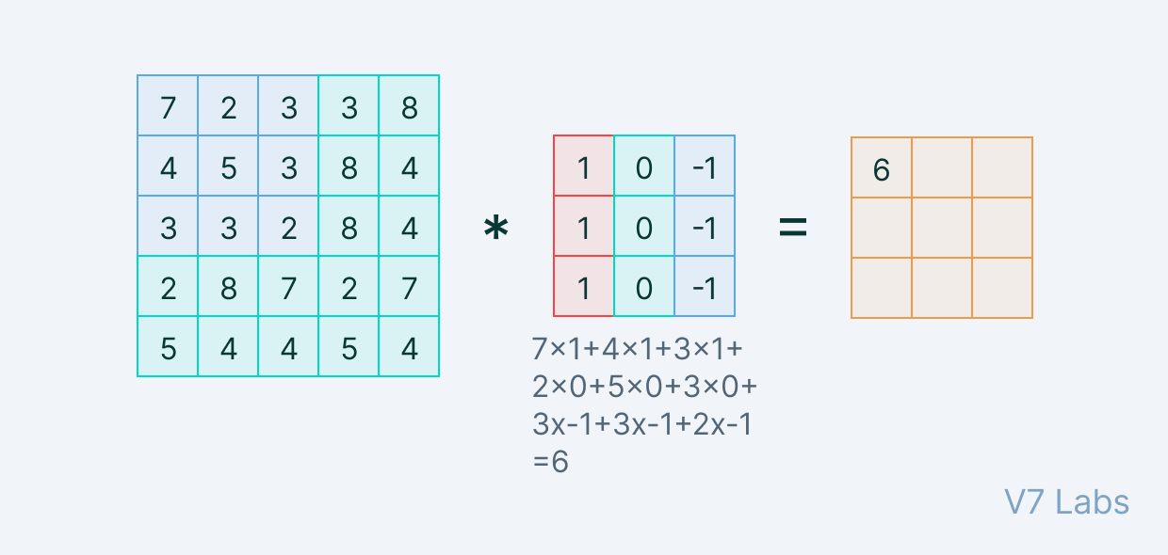
Convolutional Neural Network
Each convolutional layer is a filter or a set of filters
Each filter “convolves” with the image and creates an activation map
The output of the Convolutional Layer is generated by stacking the activation maps of the filters along the path
Notes:
What makes the CNN different is, each convolutional layer is a filter or a set of filters. Each filter convolves with the image and creates an activation map. The output of the Convolutional Layer is generated by stacking the activation map of the filters along the path. Let’s look at the image on the right side. A filter will go through the whole image step by step and record the dot products as so-called activation maps. If this is still not clear will can look at the next slide.

Slide 15
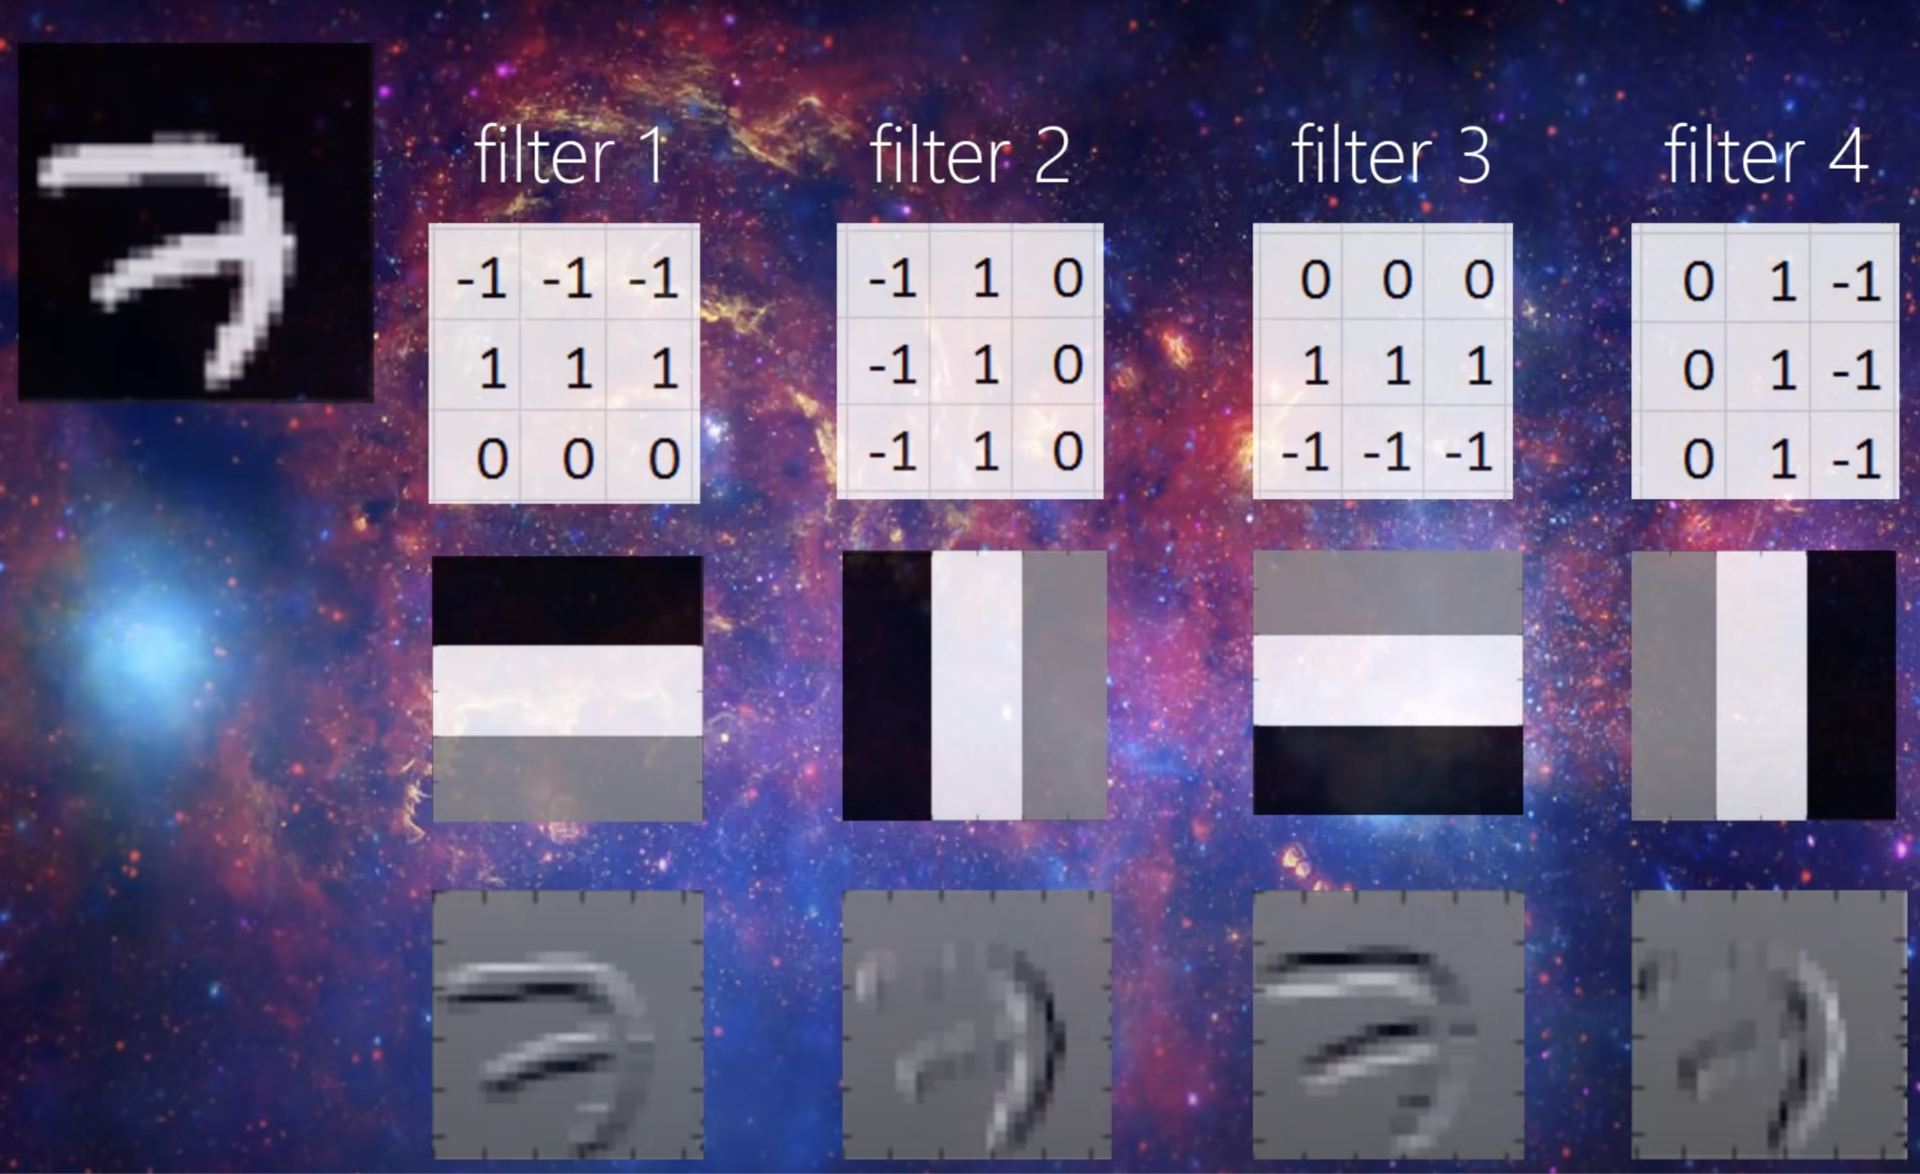
Example of CNN Application
Number recognition
Edge detection
Notes:
This is an example of hand-written number recognition using a CNN. In the top left corner, is a hand written number seven. When this image passes through the CNN, these four filters detect the edges of the pattern. For example, the filter one detects the bottom edge of the number. The filter 2 detects the right edge of the number. and so on and so fourth. In the end the output of this CNN is the combination of all the edge detection, and therefore the machine is able to recognize this image as a number 7

Slide 16
Conclusion: Convolutional Neural Network
ANN with specialization that can pick out or detect patterns and make sense of it
Popular for analyzing images because of it’s architechture
Notes:
A short conclusion, CNNs are essentially ANNs with specialization that can pick out or detect patterns and make sense of it. Because of it’s characteristics, CNNs are generally popular of analyzing images.

Slide 17

Bootstrapping
A resampling technique
Used to estimate statistics on a population by sampling a dataset with replacement
Notes:
The next topic is Bootstrapping. Bootstrapping is a resampling technique that is used to estimate statistics on a population by sampling a dataset with replacement. What does that mean?

Slide 18
Why Bootstrapping?
Notes:
And why Bootstrapping?

Slide 19
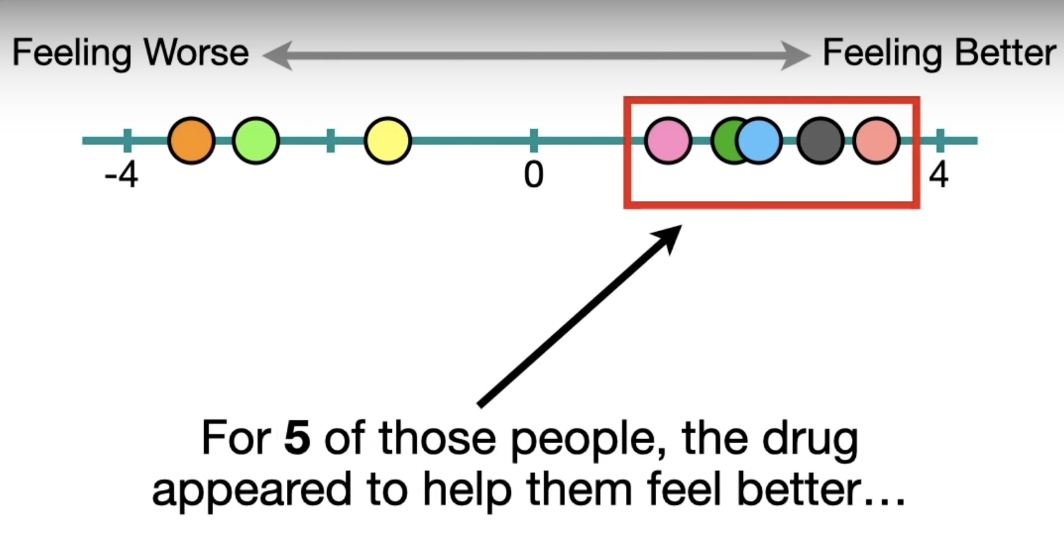
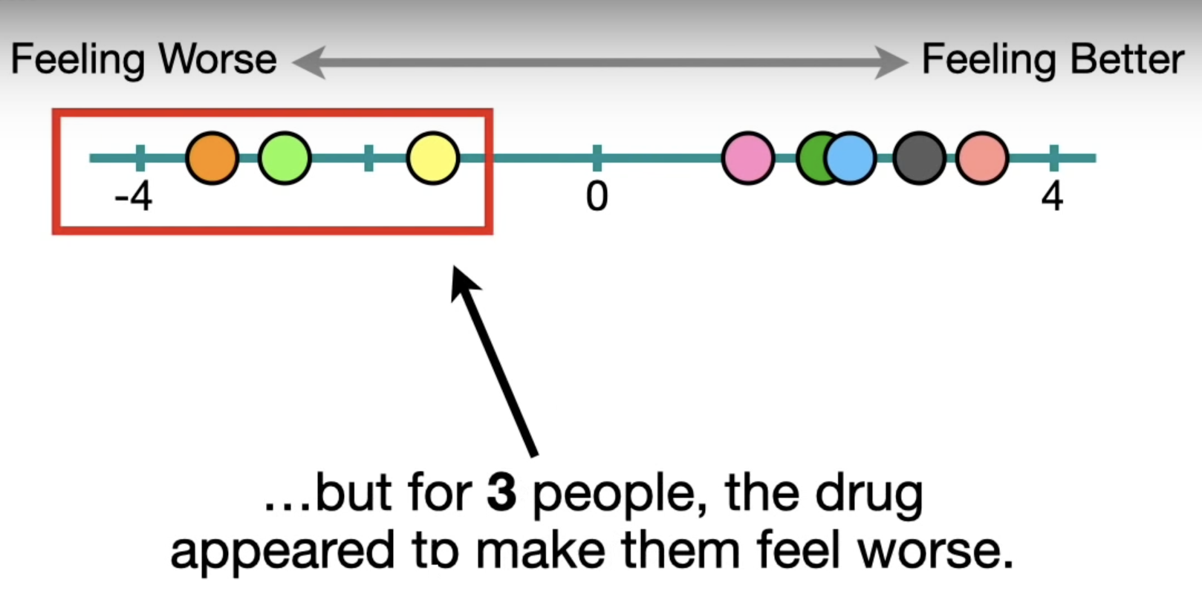
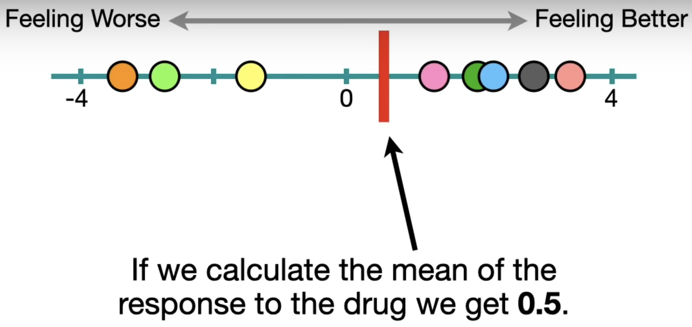
Bootstrapping
After replicating this experiment on different people, we get a gaussian distribution of the mean value
Notes:
Imagine there were 8 people taking the same drug against the same diseas. 5 of those said that they felt better after taking the drug. 3 of those said otherwise. With this dataset, we can calculate the mean of the reponse to the drug is 0.5. After replicating this experiment on different people, we get a gaussian distribution of the mean value. Which should look like something like this:

Slide 20
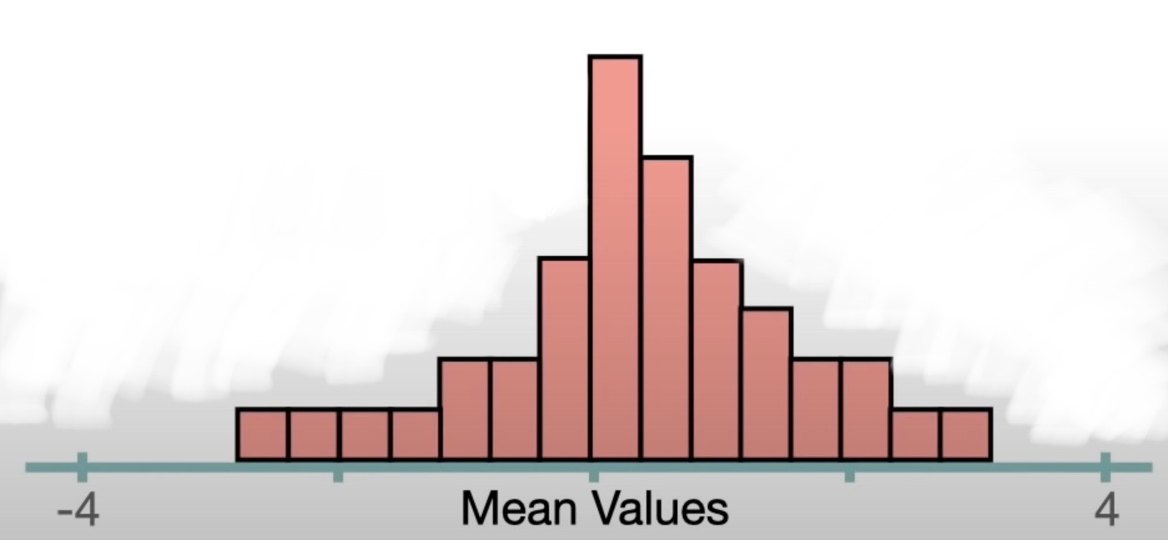
Bootstrapping
However, replicating the same experiment is possible but too resource consuming
This is where Bootstrapping comes into play
Notes:
This is perfectly fine. However, replicating the same experiment is very time consuming and required a lot or participants. And this is where bootstrapping comes into play.

Slide 21
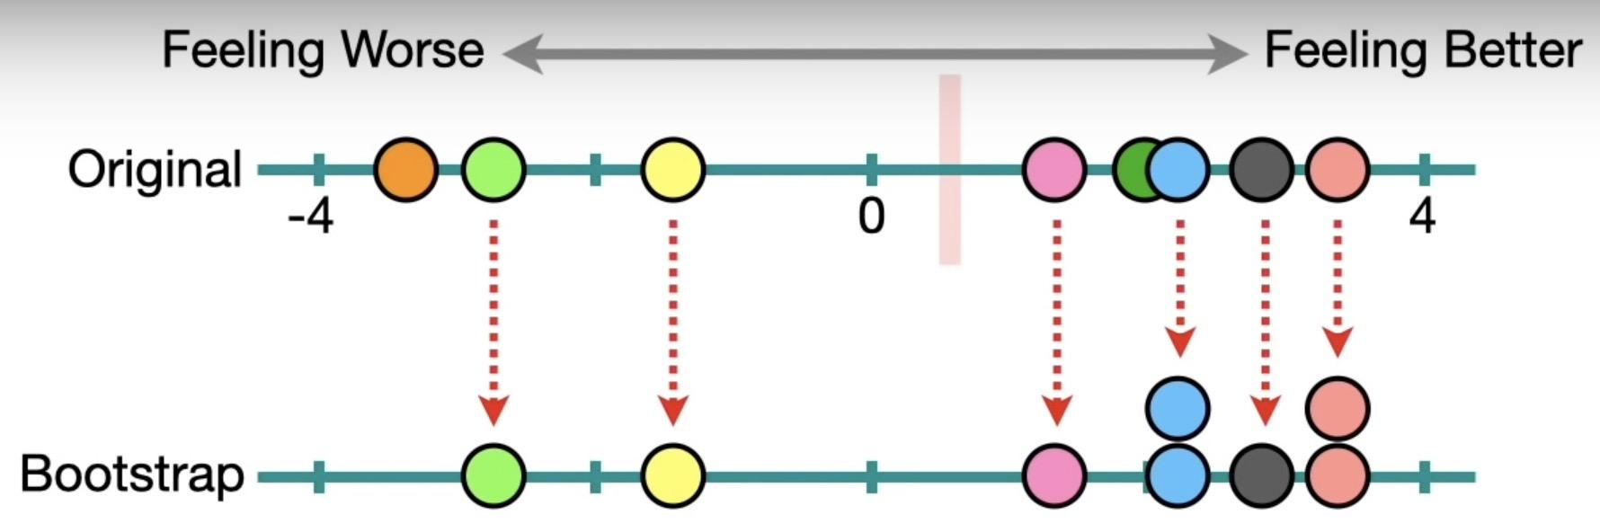
Bootstrapping
Make a Bootstrapped dataset
Calculate something
Keep in track with the calculation
Eat, Sleep, Repeat!
Selection is random
Duplicates are allowed
So-called Sampling with Replacement
Notes:
To start bootstrapping, we first need to form a Bootstrapped dataset. First we select the same amount of data from the original dataset. Something to note here is: the selection is totally random and duplicates are allowed. This is so-called sampling with replacement. If you look at the Bootstrapped dataset, you can see blue and pink are duplicated. And that is totally fine. After we have a bootstrapped dataset, calculate something. In this example, we calculated the mean value. After that we keep in track with the calculation and analyze them. And then just repeat. In the end we should also get something like this:

Slide 22
Bootstrapping
Bootstrapping “enlarges” the dataset
Reduction on time and resources
Notes:
also a gaussian distribution diagram but only with the orginal dataset and the bootstrapped dataset. Short conclusion, we can say that bootstrapping sort of enlarges the dataset. And it is benefitial on saving resources.

Slide 23
What is a Triplet Loss?
Notes:
Next topic we will talk about Triplet Loss. What is a Triplet Loss?

Slide 24
Notes:
This is a Triplet loss. Mathematically.

Slide 25
Don’t have a clue what it means?
Don’t worry, me neither.
Notes:
Don’t have a clue what it means? Don’t worry, me neither.

Slide 26
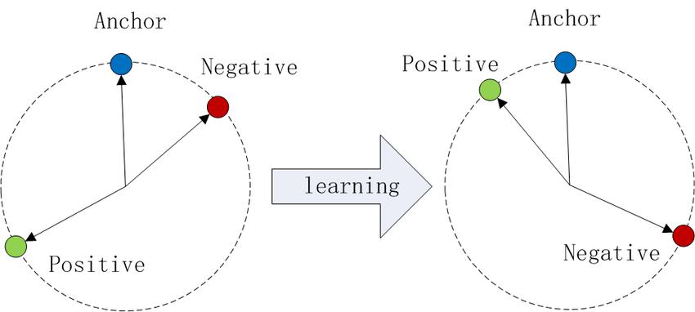
Triplet Loss
A type of loss funtinction for machine learning algorithm
Core idea: Compare
Reference Input (Anchor)
Matching Input (Positive)
Non-Matching Input (Negative)
Notes:
So by definition, triplet loss is a type of loss funtion for machine learning algorithm. The core idea is to compare the distance between the reference Input, also called as Anchor. The Matching Input, also called as Positive. and the Non-matching Input, also called as Negative. The algorithm is aiming to minimize the distance between positive and anchor and maximize the distance between anchor and negative.

Slide 27
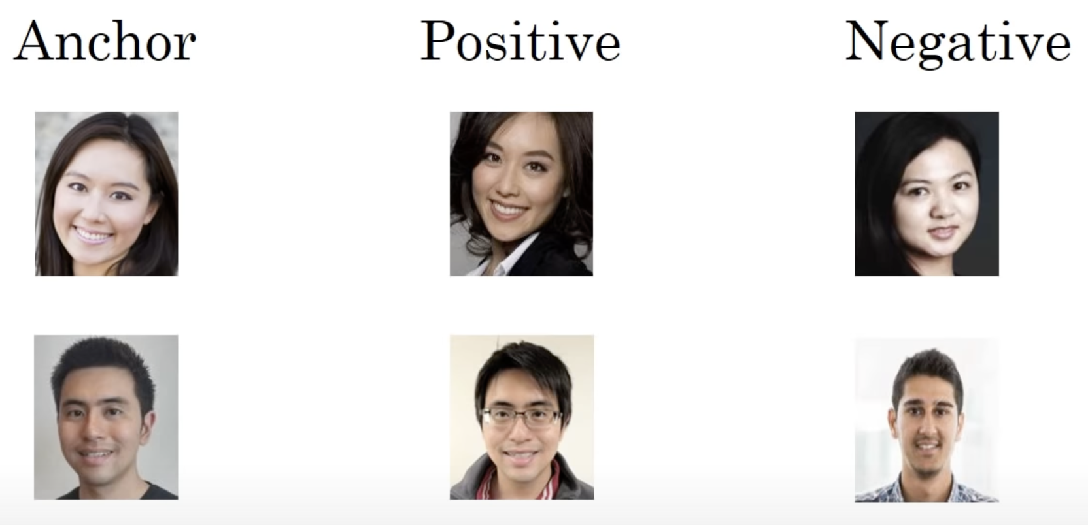
Triplet Loss
Look at 3 images at once
Anchor and positive same person
Anchor and negative different person
Compare the distances
Use gradient descent to have a backpropogating effect on the neural network
Notes:
In the case of face recognition, 3 pictures are looked at once. Anchor and positive are the same person, and Anchor and positive are different persons. It compares the distances and apply gradient descent to have a backpropogating effect on the neural network parameters such as weights, biases and so on.

Slide 28
Conclusion - Chapter: Methodology
CNN is popularly used for pattern recognition
Bootstrapping is used for the dataset issues
Triplet Loss is used for optimizing the results
Notes:
Conclusion, CNNs are mostly used for pattern recognition or image analysis due to it’s characteristics. Bootstrapping is used to solve dataset issues and improve the size of the dataset. Triplet loss is used for optimzing the accuracy of the results.
These are the topics from the methodology chapter that I think are worth presenting, hope you learned something. Thank you.

Slide 29
Datasets and evaluation protocols
Evaluation is performed on existing benchmark datasets
The first dataset is Labeled Faces in the Wild dataset (LFW) - They follow the standard evaluation protocol defined for the “unrestricted setting” using data external to LFW for training.
The second dataset is YouTube Faces (YTF) - They follow the standard evaluation protocol defined for the “unrestricted setting”, and report EER.

Slide 30
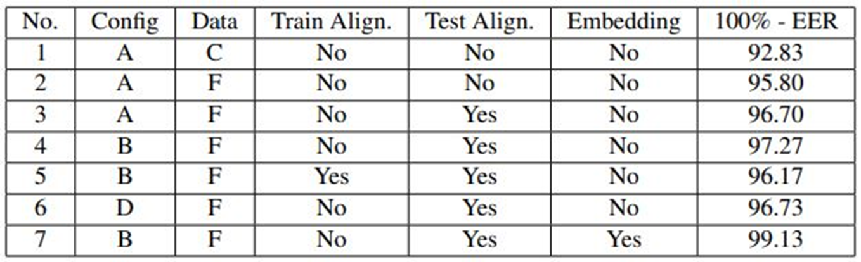
Experiments and Results
They first test several variations of the proposed models and training data using the LFW dataset to test performance.
Implementation is based on the MATLAB toolbox MatConvNet combined with the NVIDIA CuDNN libraries to accelerate training.
Experiments done on NVIDIA Titan Black GPUs

Slide 31
Component analysis
This evaluates the effect of different components of the system when training a network for face verification.
Dataset curation
Alignment
Architecture
Triplet-loss embedding

Slide 32
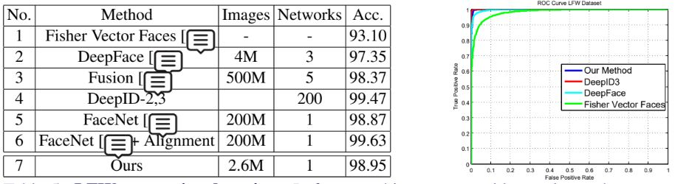
Comparison with the state-of-the-art
LFW dataset
It can be observed that they achieve comparable results to the state of the art using much less data and a much simpler network architecture.

Slide 33
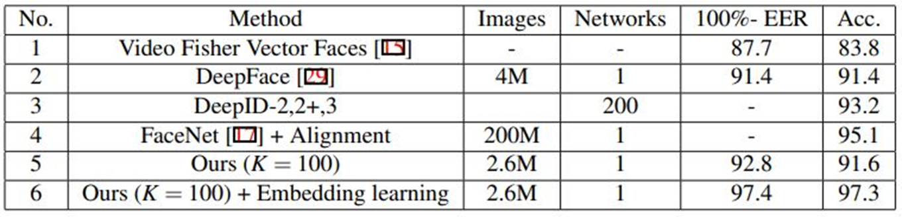
YTF dataset
The state of the art performance using our triplet loss embedding method was acheived.

Slide 34
Conclusions
Two contributions:
A procedure has been decided that is able to assemble a large scale dataset, with small label noise, whilst minimising the amount of manual annotation involved.
A deep CNN was shown, without any embellishments but with appropriate training, can achieve results comparable to the state of the art.
Also suitable for other object classes as well as fine grained tasks.

Slide 35
Thank You !

